Slide 1
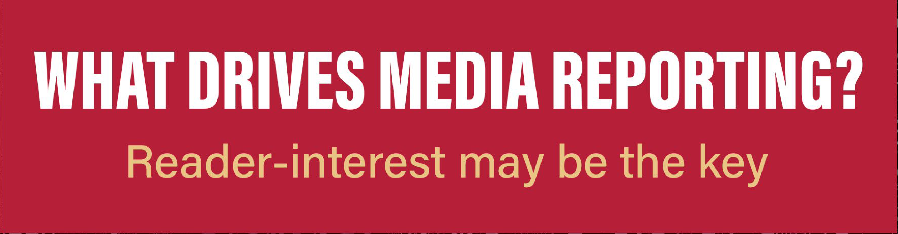
Title: Sarabun Bold, 40 points

Slide 2
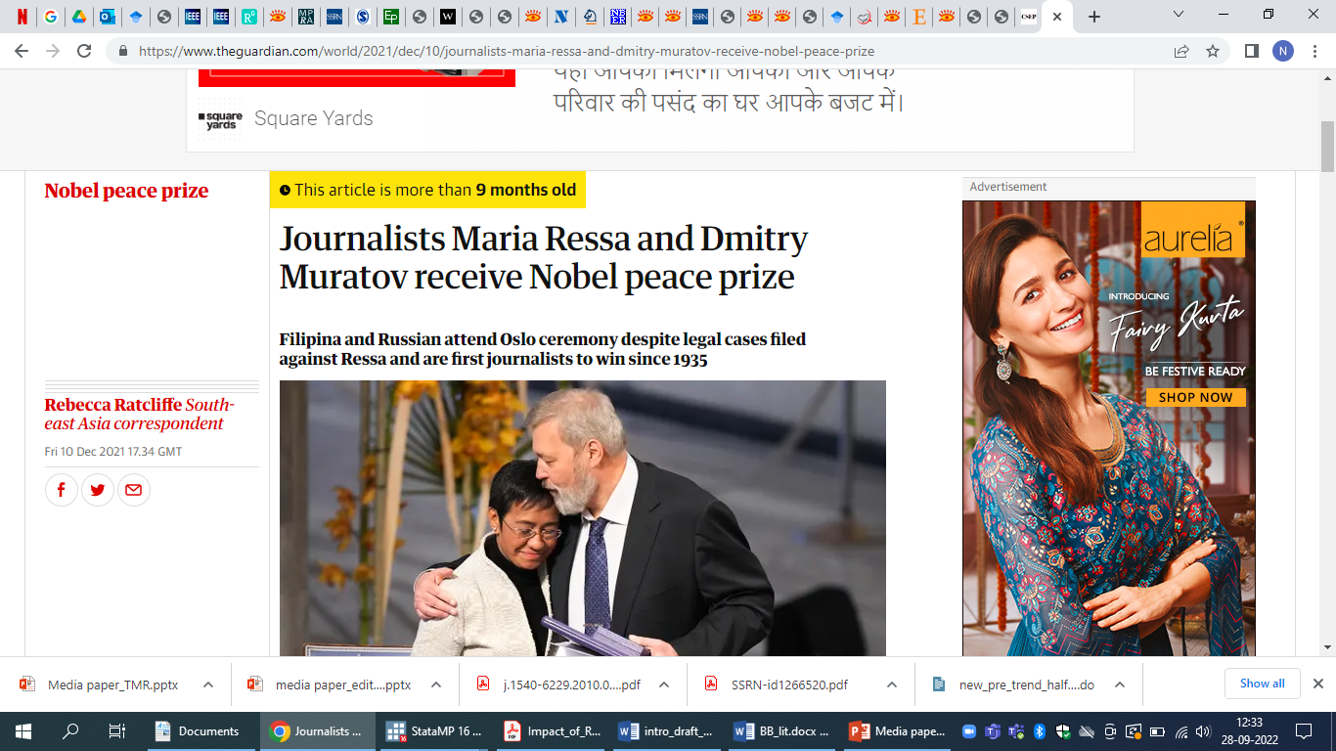
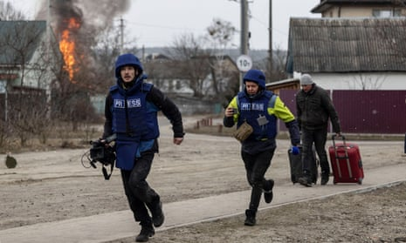

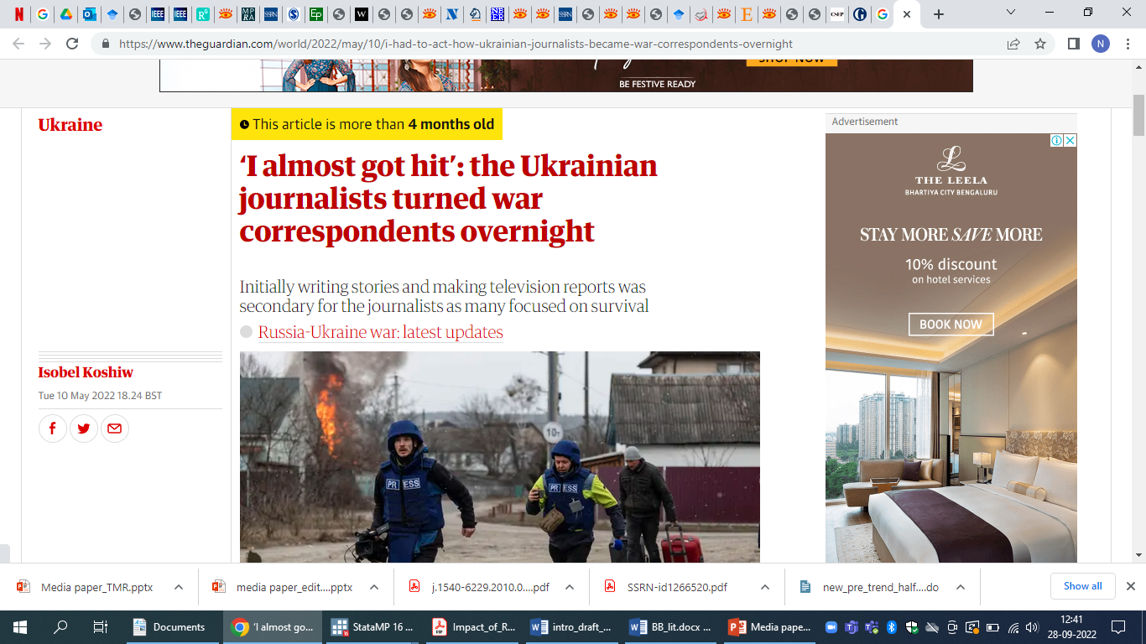
Media plays a key role
Amartya Sen has argued “it is not likely that India can have a famine even in years of great food problems. The government cannot afford to fail to take prompt action when large-scale starvation threatens. Newspapers play an important part in this, in making the facts known”.
2021

Slide 3
Indians have low trust in media
Significant trust deficit between the people and the media in India; only 38% Indians trust most news, compared to 65% in Finland, 54% in Brazil and 50% in Thailand.
Low trust is usually ascribed to media being biased or influenced. This conclusion comes naturally since 70% of media revenue comes from advertisements and just 30% from reader subscriptions.

Slide 4
Our aim is to understand how (English) media decides which conflicts/issues to raise
Conflict occurrence
Reporting
Outcome; impact of media reporting
Focus of our study

Slide 5
Three key determinants of media reporting
1
Determinants of media reporting
Media gives more importance to issues closer to their readers
Higher the severity, higher the coverage
Conflicts involving known people are covered more
2
3

Slide 6
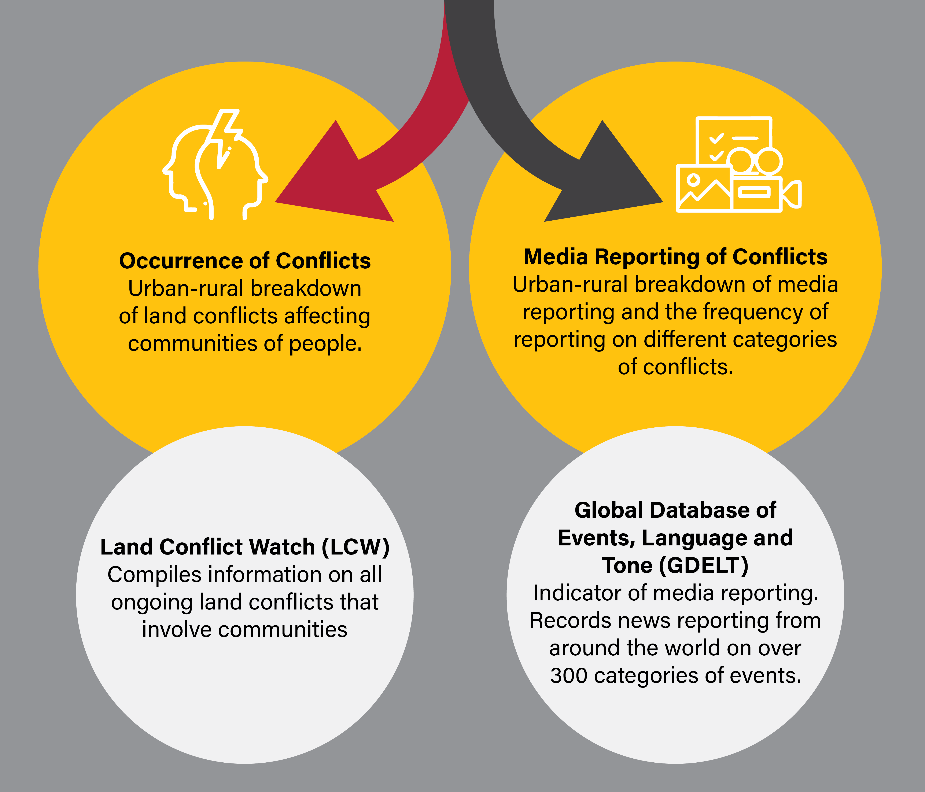
Methodology: the two pathways of our study

Slide 7
A distinctly felt rural-urban divide in coverage versus occurrence
1

Slide 8
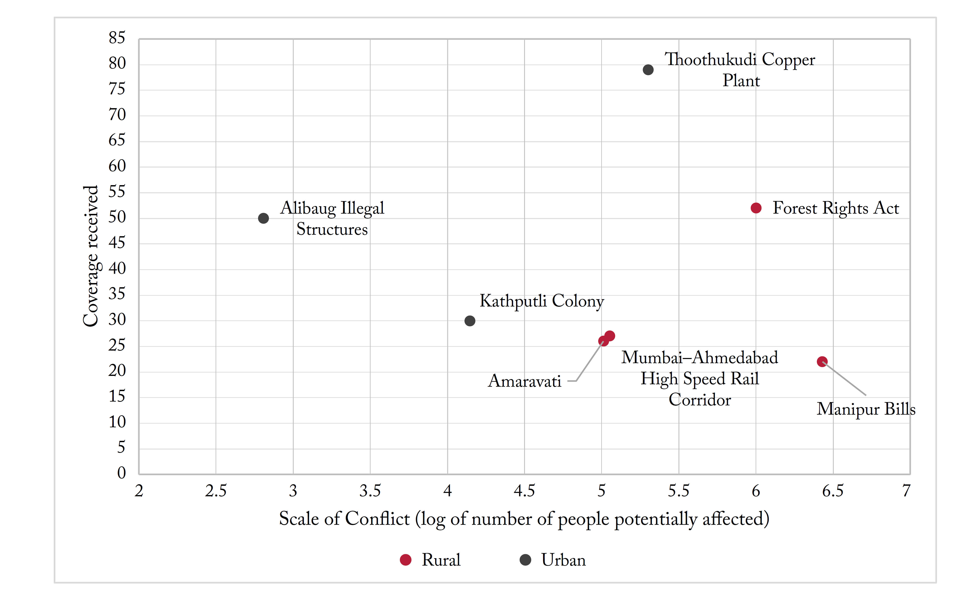
Urban conflicts are much smaller in scale, yet garner significantly more coverage
1
Source: Land conflict Watch (2021), GDELT GKG (2021), multiple news media sites.

Slide 9
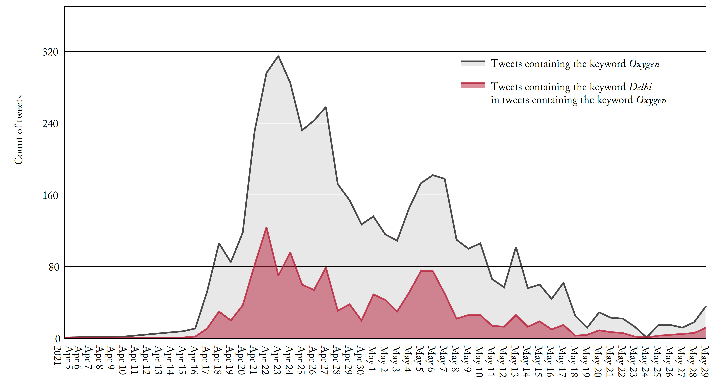
This urban skew extends to other kinds of events as well: COVID-19 oxygen shortage
1
Delhi featured heavily in the reporting of the oxygen shortage, compared to other regions. Of all the tweets on ‘oxygen’ during this time, on average, tweets mentioning Delhi made up nearly 30% of overall tweets.

Slide 10
Parties involved drive coverage
2
Coverage: 22
People potentially impacted: 2,000,000-3,000,000
Coverage: 50
People potentially impacted: 600-700
Conflict | Manipur Bills
Region | Rural
Parties involved | State, community
Conflict | Alibaug Illegal Structures
Region | Urban
Parties involved | State, individual(s)
Context: The mass discontent in the state dates back to its 2011 census count. Post agitation by the Meitei (valley) community, to introduce an Inner Line Permit system to distinguish between ‘Manipuris’ and ‘non-Manipuris’, three Bills were introduced and passed in the legislative assembly. The ‘Hill Tribes’, however, did not agree with such a system. This mutual disagreement between the two communities has been a major aggravator in this conflict.
Context: A petition was filed by an activist against illegal constructions built along the beach in Alibaug, Raigad district. The 160-170 illegal buildings, largely bungalows, were unauthorised and built within the low and high tide areas, and were in violation of Maharashtra Coastal Zone Management Authority rules.

Slide 11
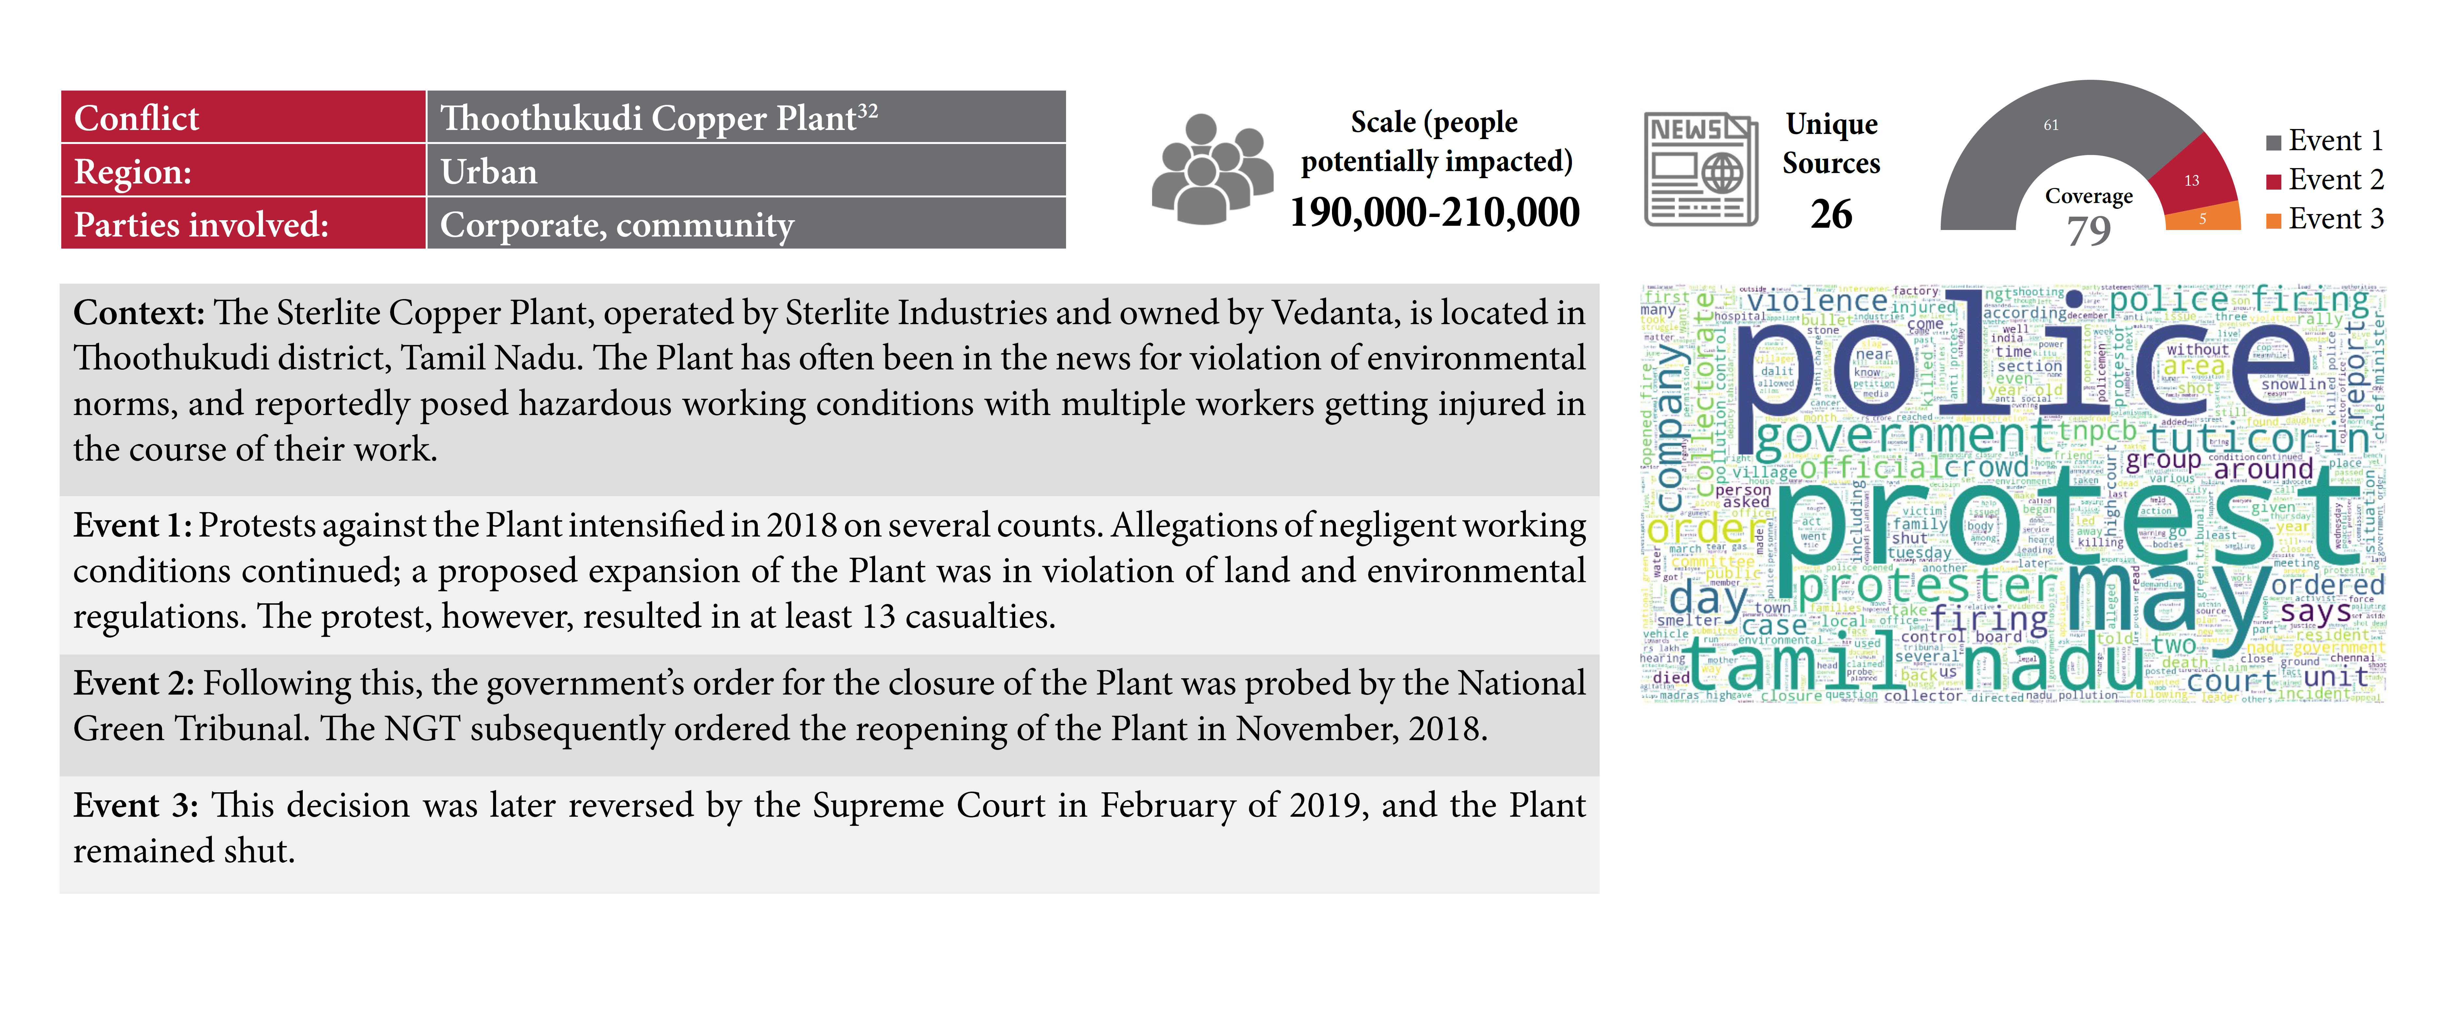
Severity of events drives reporting
3
Conflict | Thoothukudi Copper Plant
Region | Urban
Parties involved | Corporate, community
Context: The Sterlite Copper Plant, operated by Sterlite Industries and owned by Vedanta, is located in Thoothukudi district, Tamil Nadu. The Plant has often been in the news for violation of environmental norms, and reportedly posed hazardous working conditions with multiple workers getting injured in the course of their work.
Event 1: Protests against the Plant intensified in 2018. The protest resulted in at least 13 casualties.
Event 2: Following this, the government’s order for the closure of the Plant was probed by the National Green Tribunal. The NGT subsequently ordered the reopening of the Plant in November, 2018.
Event 3: This decision was later reversed by the Supreme Court in February of 2019, and the Plant remained shut.

Slide 12
What drives the rural-urban divide in reporting?
Media reporting is skewed towards urban issues.
The media industry caters to reader interest, and readers are more interested in urban conflicts.
This, in turn, is due to the location of the readers themselves.

Slide 13
English media covers urban issues more since majority of its readership is concentrated in urban centres
English language media
40 million readers
Regional language media
470 million readers
Mumbai
Maharashtra
For example, while The Times of India, Hindustan Times, and Mumbai Mirror are the three most widely read dailies in Mumbai,
The most widely read dailies in all of Maharashtra are three newspapers in regional languages, Lokmat, Daily Sakal, and Pudhari.

Slide 14
What does this mean?
Media, like any other industry, caters to the interests of its consumers, i.e. the readers
Even in a world with no inherent media bias/influence, coverage will not be perfectly representative
  This needs to be understood and communicated to improve trust in media
In a federal country like ours, governments should not rely on one/limited source of truth, as that represents interests of only a small group, and may lead to sub-optimal policy response

