Slide 1
Risk, Resilience, Climate Change
Vinod Thomas
Webinar: Centre for Social and Economic Progress
September 26, 2023

Slide 2
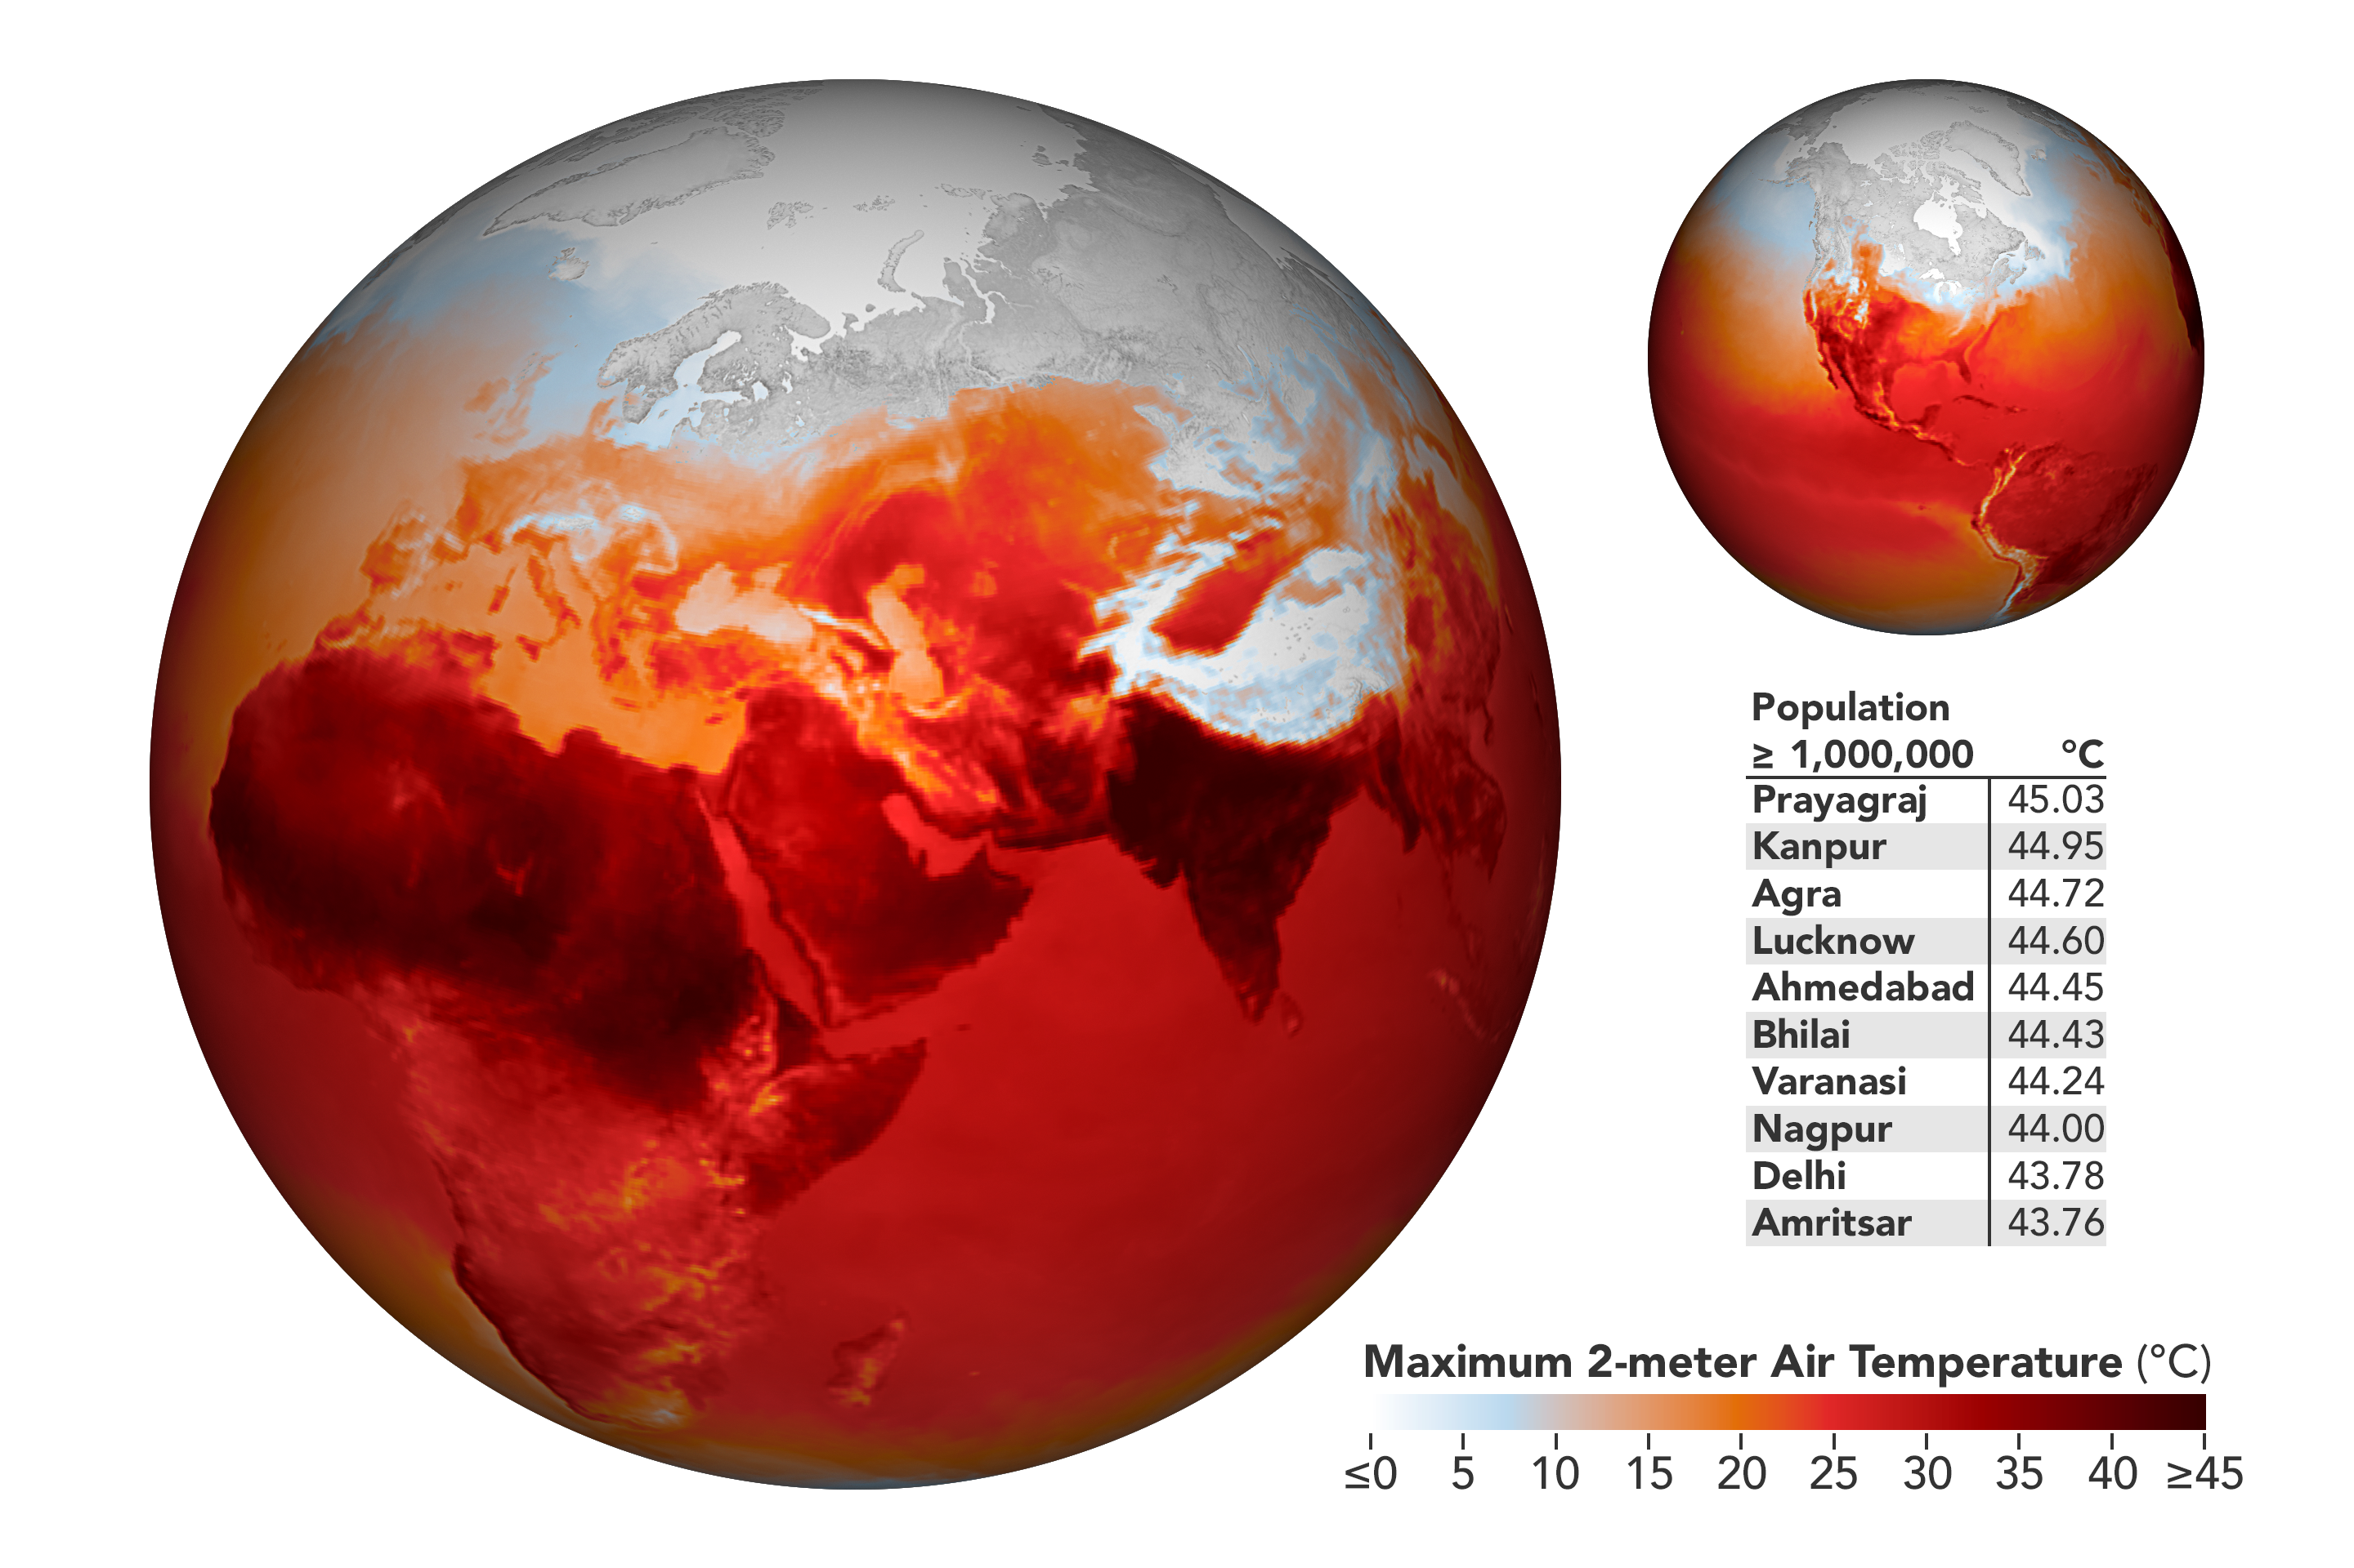
Message 1
Super Wicked Climate Change—it has been known for over a century.
“Changes in carbon dioxide levels could substantially alter temperatures through the greenhouse effect”. Svante Arrhenius, Sweden, 1896.

Slide 3
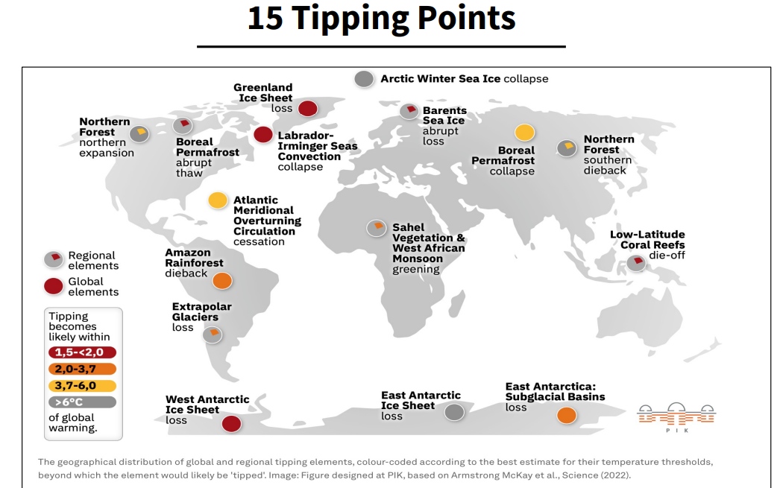
Climate Acceleration in 2023
Historic wildfires in Canada, Greece, Hawaii, Portugal, Spain.
Severe floods in China, India, Italy, Libya, Slovenia, Vermont.
Summer of 2023 hottest on record.
Antarctic Sea Ice at a ‘Very Concerning’ record low.
Source: Frank Van Gansbeke & Arnaud Brohe “Will the next financial crisis be triggered by climate change?”, 15/09/2023

Slide 4
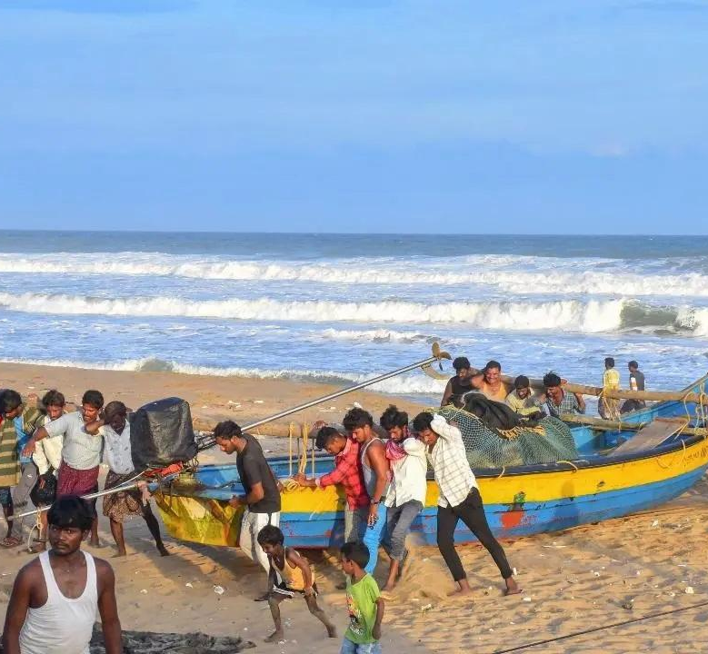
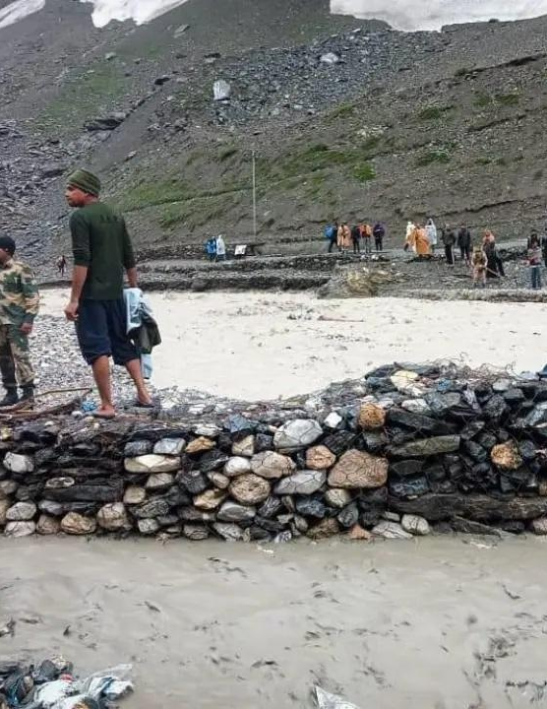
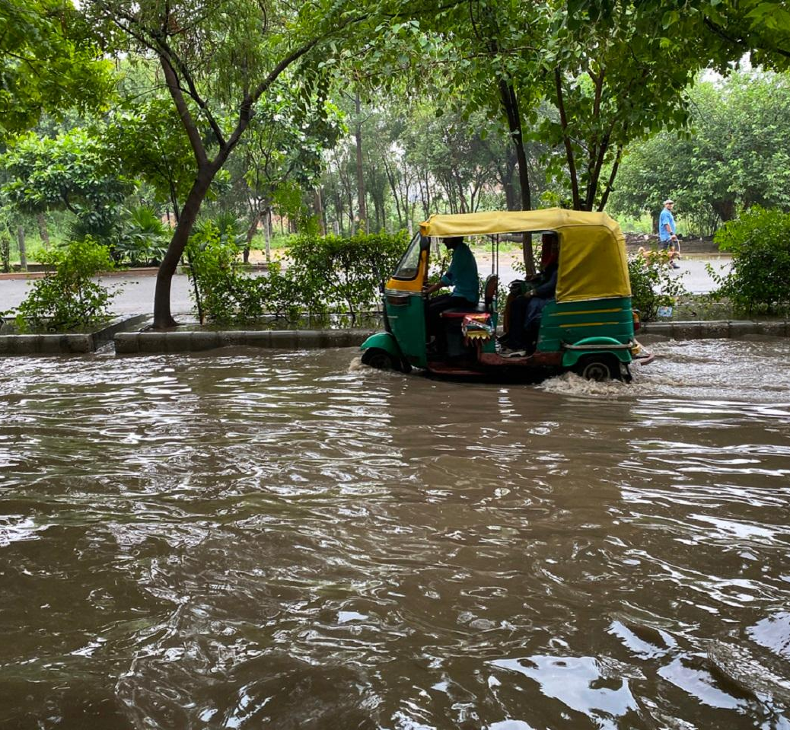
India’s Recent Climate Disasters Andhra Pradesh, Jammu and Kashmir, Uttarakhand, Uttar Pradesh, Delhi

Slide 5
Global Cost of Inaction Far Outweighs Global Cost of Action
Cost of Action
Keeping temperatures below 1.5°C would cost in energy alone of US$ 2010 2.4 trillion a year (from 2016) through 2035, with another cited total of US$36 trillion (IPCC 2019).
Also cited US$6.3 trillion a year until 2030 for climate infrastructure (OECD 2022).
Cost of Inaction
In contrast, averted global indemnities with 1.5°C could be US$125 trillion to 790 trillion by 2100 (Wei et al 2020).
Global GDP pc could fall by over 7% by 2100 with a 0.04°C temperature rise a year in contrast to a loss of 1% with a temperature rise of 0.01% (Kahn et.al. 2019).
(Social) benefit-cost ratios of climate investment revolve around 5 or more.
The Fallacy of Climate versus Poverty
When 1/3 of Pakistan goes under water (2022) and fires erase the size of Germany from Canada (2023), poverty reduction and climate mitigation become inseparable.

Slide 6
Non-Convergence of the Crisis Human activities are pushing the world outside a “safe operating space”1/.
Forest Fires
Ecological Destruction
Global Warming
Extinction of Species
1/ https://www.science.org/doi/10.1126/sciadv.adh2458

Slide 7
System Failure and Urgency for Stress Tests Escalating insurance losses, climate disasters, financial meltdown
Source:www.iopsweb.org/Working%20Paper%2019%20Stress%20testing%20and%20Scenario%20Analysis%20of%20Pension%20Plans.pdf

Slide 8
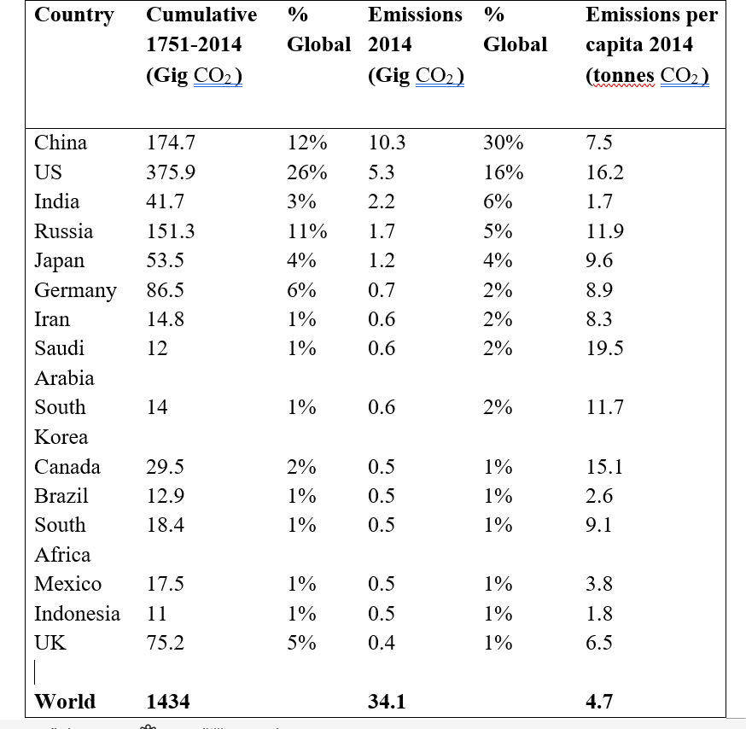
Root Cause, not the Symptoms: Stock vs Flow of Toxic Pollution
https://www.aeaweb.org/articles?id=10.1257%2Fjep.32.4.3

Slide 9
Disseminate the Attribution Reports
Mega floods in Belgium and Germany in 2021 were 1.2-9.0 times more likely than if temperatures had not risen 1.2°C (Hodgson and Heal 2021).
Human-induced climate change made the 2022 heatwave in India and Pakistan “30 times more likely” (World Weather Attribution 2022).
The heatwave that hit the US in June 2022 was 150 times more likely due to climate change (Lombrana, 2021).

Slide 10
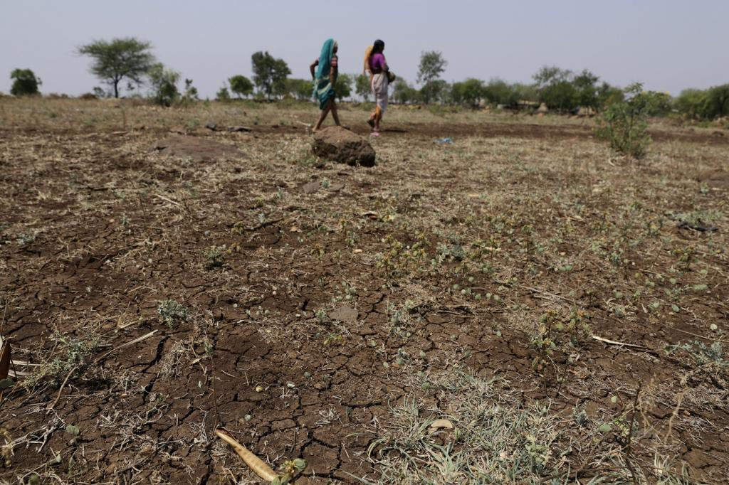
Message 2
We can no longer adapt our way out of the climate conundrum.
“Extreme heat, lost labor hours, and 4.5% India’s GDP at risk by 2030…. 3%-10% of annual GDP loss by 2100 without climate mitigation”. Reserve Bank of India, 2023.

Slide 11
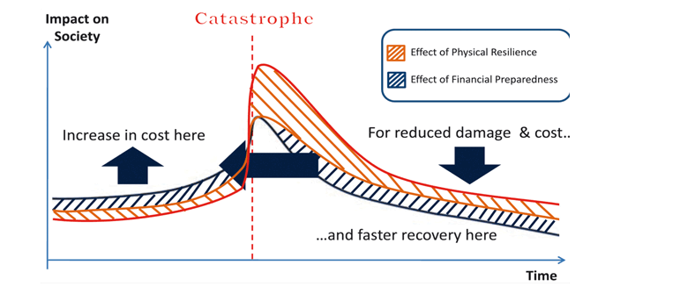
Adaptation: Multi-Hazard Early Warning
States need better access to global risk data, like from WMO.
Central and local integration of information on infrastructure, urban and health.
24/7 operational interactive platform accessible to all.
Reach people in remote places and difficult terrains.
https://public.wmo.int/en/resources/bulletin/building-climate-resilience-through-disaster-risk-reduction-0

Slide 12
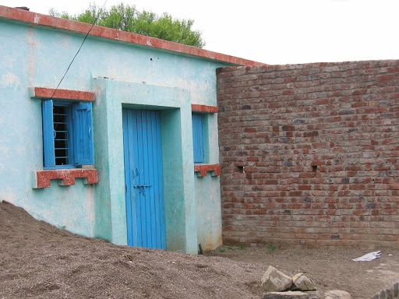
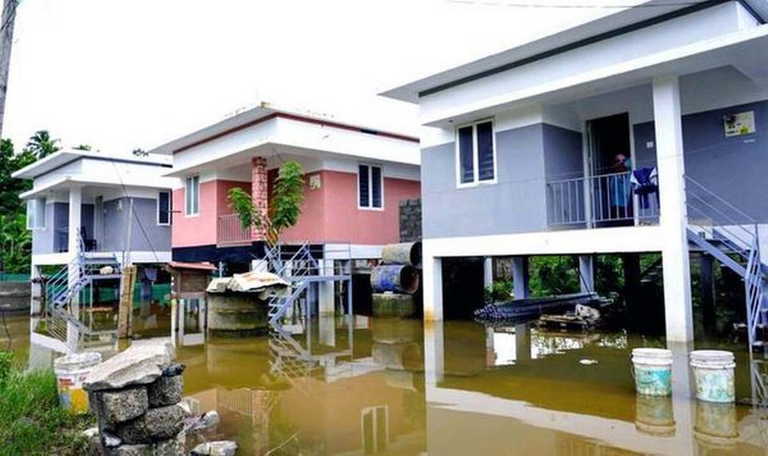
Disaster-Resilient Housing: Maharashtra, Kerala
Tying down a roof or using storm shutters for windstorms.
Sourcing materials locally for a superior fit.
Financing instruments to attract the private sector.
AI to assess hardware defects and anticipate problems.
Lower level to serve as flood corridor.
Elevated living space, including on stilts.

Slide 13
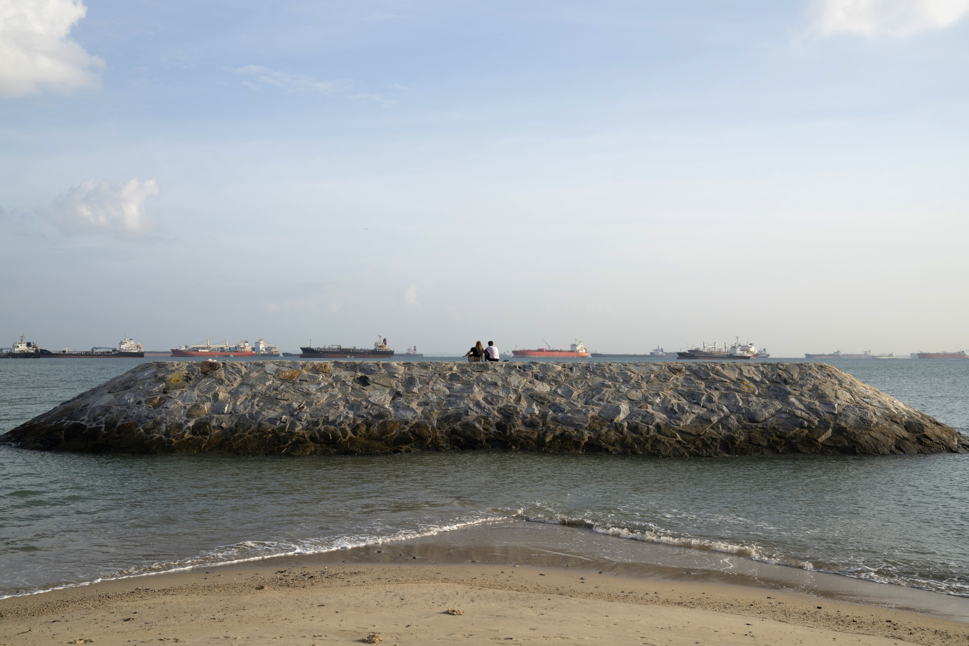
Capital Intensive Adaptation
Singapore’s Plan for Seawalls

Slide 14
Limits of Adaptation
It is common to flag adaptation shortfalls: sirens failing in Maui’s 2023 fires; budget cuts proving fatal in Canada’s 2023 fires; dam mismanagement in Kerala’s 2018 floods.
But far bigger is the extremity of the hazard, as once in a 1000 years turns frequent.
Experience no longer a sufficient guide; go beyond the norm, as the junior high students in Kamaishi City during the 2011 Tōhoku tsunami.
Inadequacy of China’s sponge cities and Japan’s underground reservoirs shows no amount of adaptation can keep up without mitigation.

Slide 15
The Gaping Mitigation Gap
https://climateactiontracker.org/countries/

Slide 16
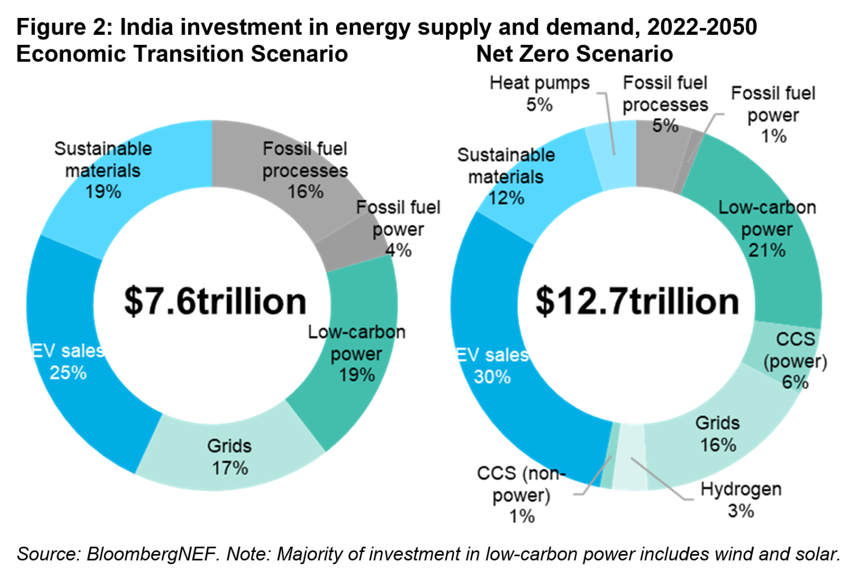
Central Task: Accelerate Energy Transition
US and Japan 2050, China 2060 and India 2070 zero net carbon are non-starters for a 2 degrees temperature hike.
India can achieve net zero in 2050 (rather than face a 2.6°C rise) with US$438 billion a year (5% of future GDP), and investment in fossil-fuel power dropping by half.
To remove remaining emissions, carbon capture and storage, nuclear, hydrogen and EVs need to be ramped up.
Implementation at the state level, including financial performance of distribution companies, is vital.
https://about.bnef.com/blog/faster-deployment-of-clean-power-such-as-solar-wind-and-evs-can-enable-india-to-peak-emissions-before-2030/
“A Strategy for India to Reach Net Zero”, Montek S. Ahluwalia & Utkarsh Patel, September 24, 2023.

Slide 17
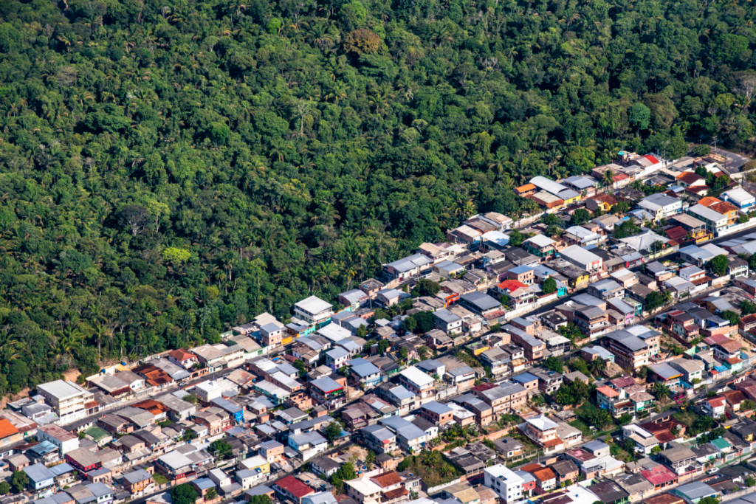
Message 3
Technology and finance follow prices and values—and a groundswell of public opinion.
“Noone would know from national statistics that our natural capital is being degraded even as GDP is growing”. Partha Dasgupta 2022

Slide 18
Perverse Fossil Fuel Subsidies
Subsidies for oil, coal and natural gas are US$7 tn or 7.1% of global GDP, more government spending on education (4.3%) and about 2/3 of health (10.9%).
The World Bank (and others) provided some US$3.7bn in trade finance in 2022 funding oil and gas developments.
China and India mark a strong increase in renewables. But starting with 37 GWs of new capacity in 2023 so far, India (as many others) has plans for new coal power plants for 2027-32.
https://www.imf.org/en/Blogs/Articles/2023/08/24/fossil-fuel-subsidies-surged-to-record-7-trillion; https://www.urgewald.org/node/1773; https://energyandcleanair.org/publication/chinas-new-coal-power-spree-continues-as-more-provinces-jump-on-the-bandwagon/

Slide 19
Time for Ambitious Carbon Pricing
Three ways: (i) carbon tax, as in Korea and Singapore; (ii) emission trading system, as in California and China; (iii) an import tariff on the carbon content as EU is proposing.
46 countries price carbon, covering 30% of GHGs and at an average price of only US$6 a ton of carbon, ranging from Japan’s US$2.65 a ton of CO₂ to Denmark’s US$165 (2030).
EU, British Columbia, Canada, and Sweden show emission response and net benefits, but this needs complementary investments.
IMF’s has a sound proposal for price floors of US$75, US$50, and US$25 per ton of carbon for the US, China, and India, respectively, using existing fiscal arrangements.
But indicative of the political economy, a conservative government in Australia repealed the 2012 tax just two years after it was instituted.

Slide 20
Forests, a low hanging fruit, under fire
Forest fires destroying an additional Belgium globally each year.
Biodiversity is being decimated with ½ of the species suffering a population decline.
Afforestation target notwithstanding, Parliament amends India’s Forest Conservation Act of 1980, that will worsen deforestation 1/.
Meanwhile,
The rate of deforestation under new Brazilian administration drops 34% in first 6 months.
1/ https://www.deccanherald.com/opinion/an-ecological-crisis-legislated-2685348

Slide 21
Paradigm Shift
The climate crisis is a chance to target the quality of growth including natural capital rather than (gross) quantity.
It pays to frontload climate investment during 2020s, as immediate restructuring is far more cost effective than gradual changes.
Asia could gain a competitive edge in agriculture, energy and transport with a decisive shift to renewables and low carbon growth.

Slide 22
Thank you!

