Slide 1
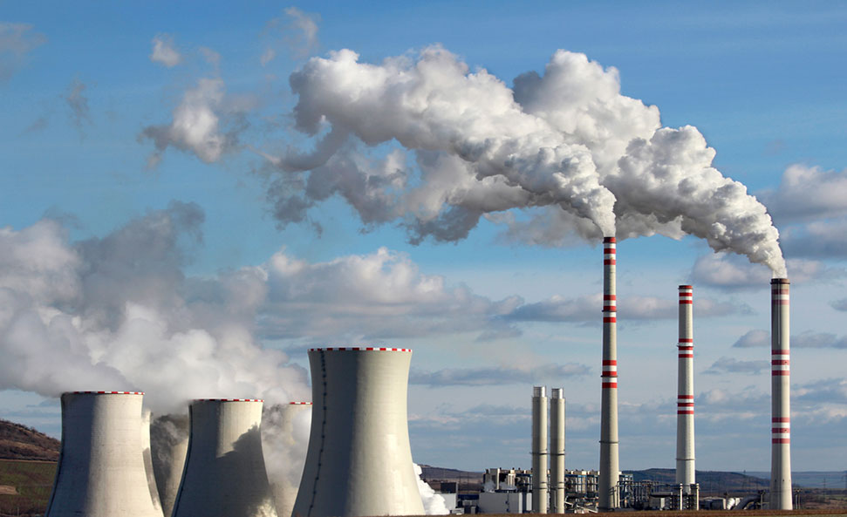
Carbon Border Adjustment Mechanism- How are countries preparing for the transition

Slide 2
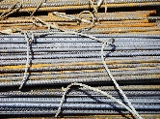
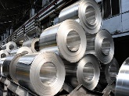
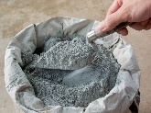
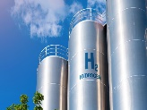
Introduction to CBAM
Aim:
Counter measure against Carbon Leakage
Equalising the price of Carbon between domestic products and imports
Equal Carbon Pricing
Coverage:
Emissions Coverage:
Scope 1 (Direct)
Scope 2 (Indirect)
Countries:
Non-EU countries, including India, that export carbon-intensive goods to the EU (Iceland, Norway, and Switzerland exempted)
Exemptions:
If a non-EU producer has already paid a carbon price in a third country on the embedded emissions for the production of the imported goods, the corresponding cost can be fully/partially deducted from the CBAM obligation.
Iron and Steel
Aluminium
Production in Europe
EU ETS – charging domestic industries for their carbon emissions
Production Abroad
CBAM certificates to be purchased by EU importers to cover difference between EU and non-EU CO₂ cost
Cement
Fertilizer
Electricity
Hydrogen

Slide 3
Rollout Roadmap
1
2
3
4
27 month transition period
No tax payment
Details of carbon content to be shared
starting January 2026, exporters will start paying the Carbon Border Tax on Aluminium and Steel and other covered products.
starting 2034, by this time, all the goods and materials imported into the EU and covered by EU ETS will be taxed under CBAM.
will extend from 2026 to 2034, when new products will be taxed under CBAM.
Mars
Despite being red, Mars is a cold place full of iron oxide dust

Slide 4
Challenges

Slide 5
India: Iron & Steel (24%), Aluminium (9.1%) most exposed
 | Absolute Exposure | Relative Exposure
Mean Value | 0.01 | 0.01
Median Value | 0.00 | 0.00
 | Absolute Exposure | Relative Exposure
Mean Value | 0.01 | 0.00
Median Value | 0.00 | 0.00

Slide 6
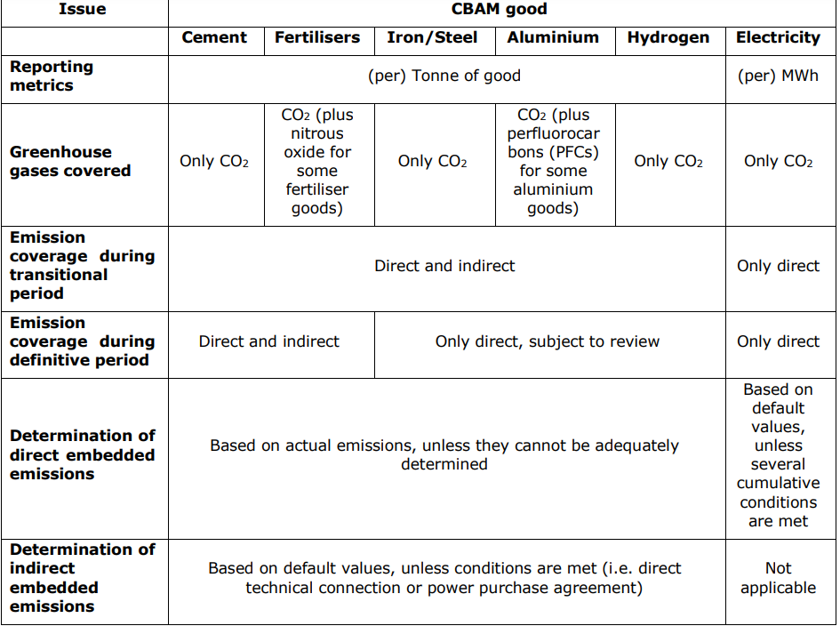
Extensive compliance and reporting – a challenge for firms
Direct and Indirect emissions
Specific CN/HS codes
Geographic information, installation information, production route
Third party verified
Default values if information not provided
Carbon price paid in domestic country
Importers registration
Penalty for non compliance

Slide 7
Mitigation Measures

Slide 8
How are countries preparing for CBAM? Governments
Negotiations with the EU/Signing new FTAs
Providing guidance and support to businesses.
Developing their own domestic carbon markets/CBAM
Improving Monitoring, Reporting and verification systems (MRV)
Promoting renewable energy by funding R&D, regulations, incentives, setting targets etc.
Collaborating with international institutions such as EBRD, WB to fund projects
Assessing country's exposure to CBAM

Slide 9
Cross Country Comparison

Slide 10
Measures by Governments- Examples
India
Establish its own Carbon Credit Trading System- CCTS
Seeking exemptions For MSMEs through FTAs
Recognition of its carbon verifiers
Push for Green Steel with pilots running - the steel ministry is preparing a blueprint for green steel production
Initiatives to scale up Net- Zero Technologies like Carbon Capture and Storage (CCS) plants are underway
Selective Export Tax under consideration as per news reports
Turkiye
Decided to commit to the Paris goals under the influence of the EU CBAM
Announced its “Green Deal Action Plan” and “Hydrogen Technologies Strategy and Roadmap”
The EBRD is working with Turkey in multiple ways to strengthen Turkish interest in carbon pricing
Developing sector-specific decarbonization road maps for crucial industries, including steel, aluminium, cement and fertilizer.

Slide 11
Measures by Governments- Examples
Indonesia
The government launched the Indonesia Carbon Exchange (IDXCarbon)
Egypt
Unveiled “National Climate Change Strategy 2050. The Egyptian Government plans to execute this strategy through issuance of green bonds, and procurement of funds via the World Bank, the European Bank for Reconstruction and Development (EBRD), and other financial institutions
Japan
Launched a voluntary national market for carbon offsets
China
Expanding its already existing ETS which currently covers only power sector to cover sectors eligible under the EU’s CBAM
Establishing national accounting and verification systems and standards for emissions-intensive industrial companies
Vietnam and Ukraine
Plan to establish their own ETS

Slide 12
Measures by Governments- Examples
South Korea
Requested that offshore manufacturing companies be allowed to submit data directly to the CBAM registry to protect confidentiality
Asked for the allowance of adoption of the K-ETS standard to calculate embodied carbon emissions
Asked for elimination of transition period penalties
Korea has also been discussing its own CBAM system.
United Kingdom
Working on the legislative process to establish its own CBAM
Linking its domestic ETS with EU ETS as the scheme is modelled on their scheme
Mandatory product standards (MPS)
promoting the market for low carbon goods
United States
Considering its own CBAM

Slide 13
How are countries preparing for CBAM? Industries
Internal carbon pricing/ setting up emissions targets
Conducting a thorough assessment of their carbon emissions
Investing in low-carbon/carbon capture technologies
Engaging with different stakeholders such as suppliers, customers, investors , employees, and policymakers
Assessing the impact of CBAM
Enhancing measuring, reporting, and verification mechanisms
Preparing documents related to emission related details, re working contracts, undergoing emission audits etc.

Slide 14
Measures by Indian Companies
Jindal Stainless
Involving third parties for automating emissions reports
HINDALCO
Incorporating internal carbon pricing
Implementation of innovative technologies like Carbon capture, red mud neutralisation with CO2, Zero Waste to landfill
Kalyani Steel
Utilizing solar power in its electric arc furnace
Arcelor Mittal
Joining platforms for net-zero transition such as Energy Transition Commission (ETC), the World Economic Forum, the Centre for Climate Aligned Finance, IEA, and SBTI
Tata Steel
Carried out trials with hydrogen injection in blast furnaces
Commissioned a carbon capture plant
Set up a steel recycling plant
Engages with suppliers to assess their environmental performance
SAIL
Bolstering domestic coking coal production
Alternate Markets
Exploring sustainable solutions with SMS Group
Vedanta
Adopting internal carbon price
Launched ‘Restora’ , India’s first low carbon green aluminium

Slide 15
Measures by Foreign Companies (Steel)
China
Baowu Steel Group: Hydrogen steelmaking and smelting reduction
Jianlong Steel and Bayi Steel using smelting reduction
HYBRIT Model: Pilot underway
European Union
H2 Green Steel: signed contracts with automotive and construction companies that need low-emissions steel. Used these contracts to raise $105 million.
Building a steel plant using green hydrogen
Ukraine
Metivest: Focus on hydrogen, natural gas, and improving the quality of raw materials.
Projects include: Cold rolling mill and colour-coated rolled steel
United States
Nucor Steel: Technologies like off-gas heat recovery, burner improvement, highly efficient power supply systems, scrap preheating alternatives, carbon sequestration
Transparency in reporting
Russia
Reduction of fuel and flux consumption due to increased Fe content in concentrate
Rotating air heater replacement
Turbine air blower
Brazil
Gerdau: Joint venture with Shell for solar energy generation to be used in Steel production

Slide 16
Measures by Foreign Companies (Aluminium)
Egypt
Egyptalum: Aligning operations with the Aluminium Stewardship Initiative ASI's rigorous standards
Russia
Rusal: partnered with companies producing high-quality aluminium alloys
Promoting enhanced product traceability (ALLOW digital passport)
Advocates for CO2 disclosure
South Africa
Hulamin: Greenhouse gas emissions target approved by the Science Based Targets Initiative
Measures to prevent waste mixing and contain spillages/leaks
Engaging with the value chain on environmental issues
Educating employees on responsible use of resources

Slide 17
Issues for Discussion
What are the gaps/deficits in the current Indian responses?
What other forms of stakeholder engagements are required?
What further/ additional expectations from the EU authorities?
CBAM’s conformity to WTO principles
How to address emissions embedded in Supply Chains across countries? Any structural impact?
How can firms be incentivised for gradual/ eventual alignment with CBAM?
Potential measures to help MSMEs cope with CBAM
Accounting of ESCerts trading under PAT scheme and RECs under RPOs in the CCTS?- ETS Mismatch
Verification, training/skilling, familiarisation, communication, feedback mechanisms
Are the above enough to retain competitiveness? Can India gain from opportunities, e.g., export tax, technology, etc.?

